Slide 1
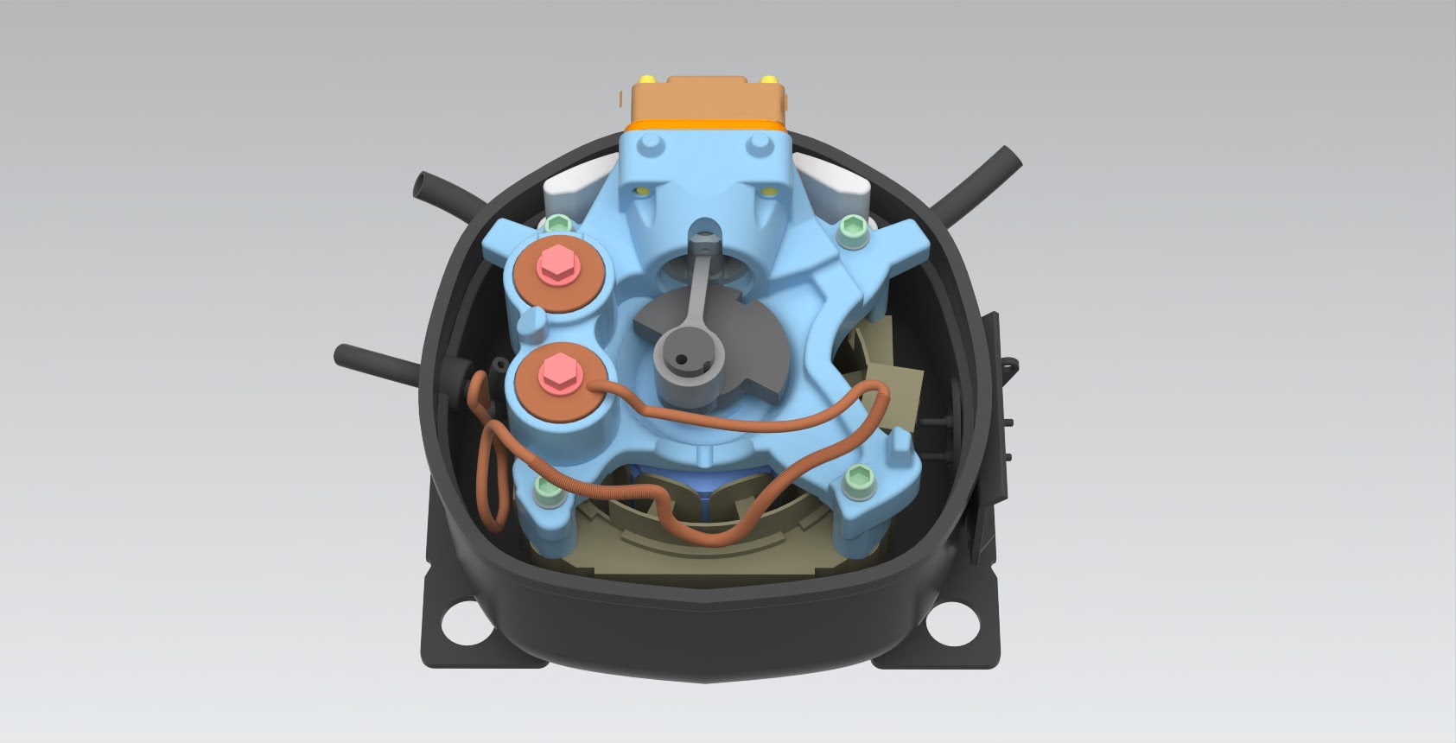
Mech 203 - Final Project
Group 4: Reciprocating Compressor
Ali Bora Albayraktar
Hakancan Öztürk
Gökhan Uysal
Berk Özdemir
Umut Serhan Sarıcan
Doruk Pelin
TA: Atacan Oral
Kompresör?

Slide 2
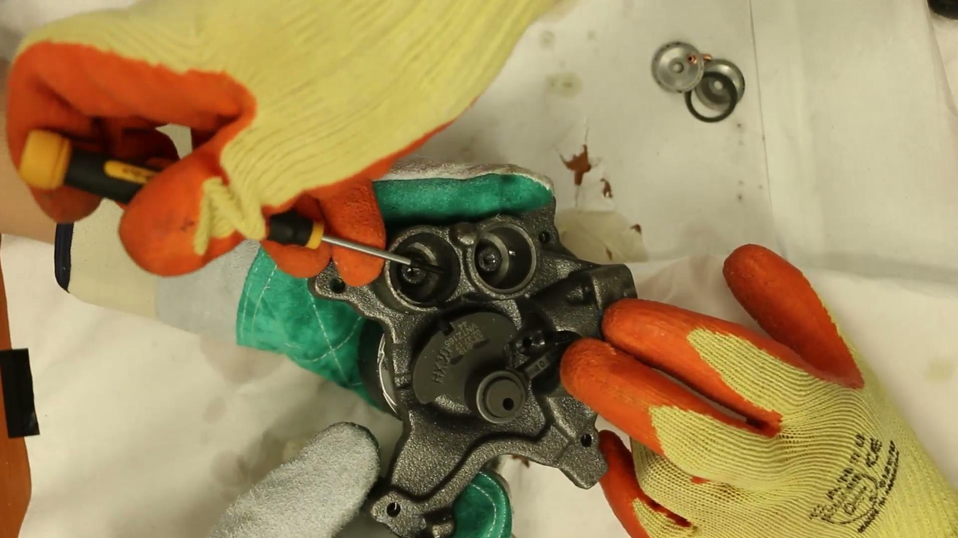
Reciprocating Compressor
One of the oldest compressor types, which is generally being used in refrigerators.
The working principle of these compressors are similar to combustion engines, where refrigerant is being compressed by a piston.
Contains a lot of part and are complex. These compressors are impossible to repair once the compressor is damaged.

Slide 3
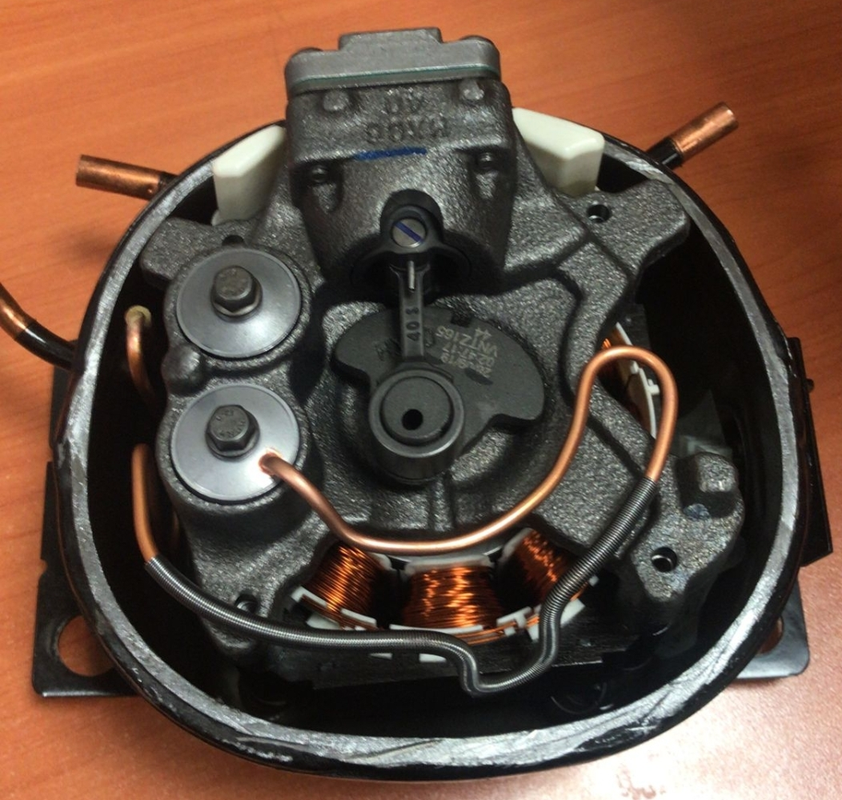
Specifications
3.70 kg Total weight
1300-4500 rpm
220 Volt - 60 to 225Hz
R600a (Flammable Gas)
Hermetic (Welded)

Slide 4
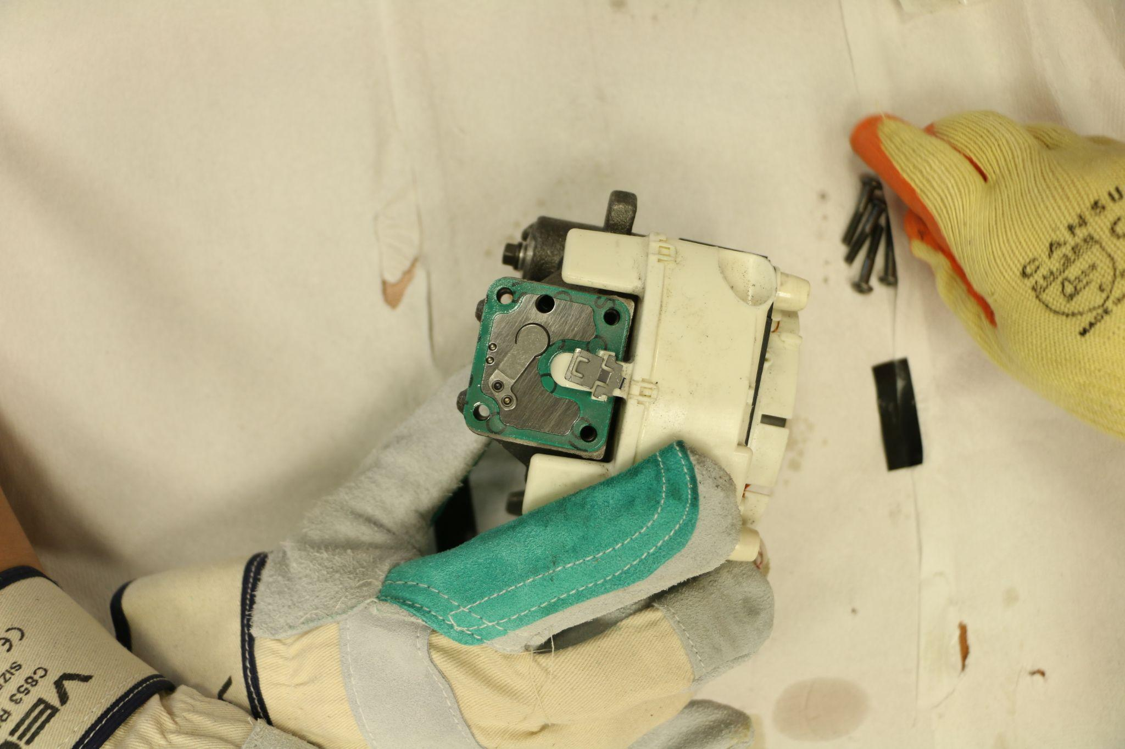
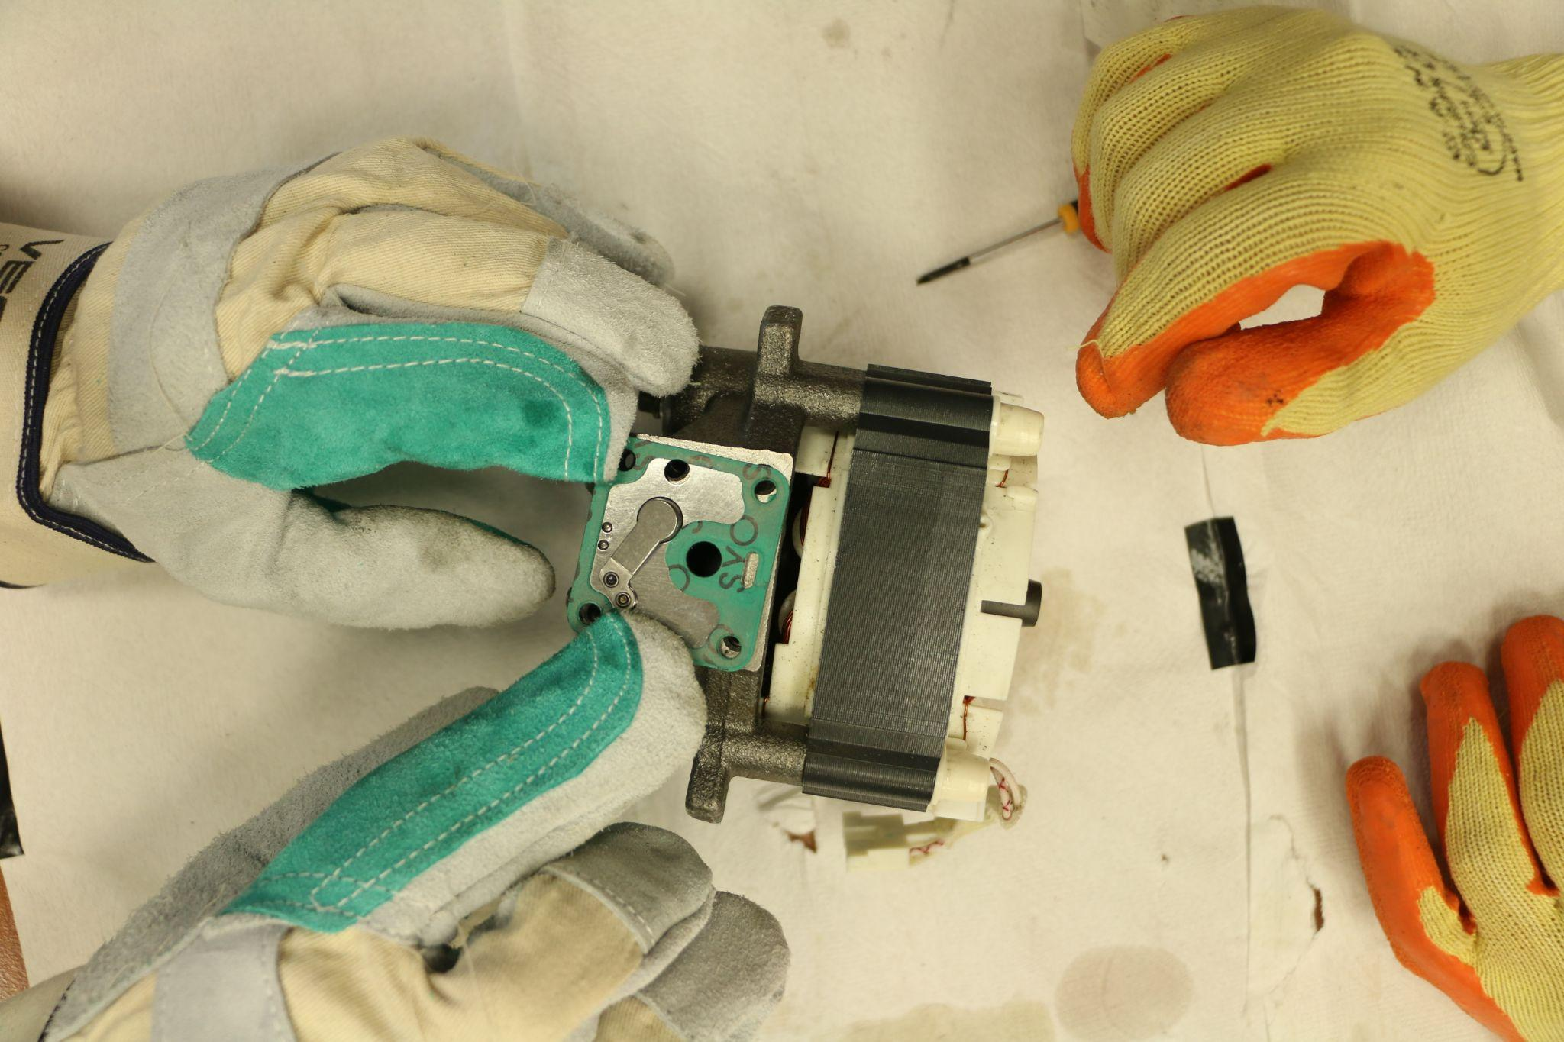
Parts and Disassembly
Number of parts: 35 unique 46 in total
How many hours: Around 20-80 per group member
Some of the challenges: Free form surfaces, tiny measurements, Measuring angles on non-uniform surfaces, disassembling interference fits
Notes:
Add video

Slide 5
New Functions of Siemens NX That We Learned
Sheet Metal Model and its features
Spline
Sweep Along Guide
Text
X-form
Helix
Thread
Swept
Notes:
Komutlari cizim bazli anlatim

Slide 6
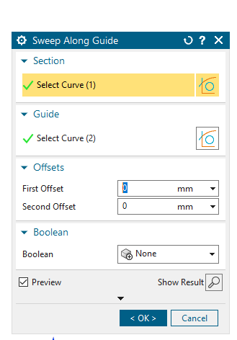
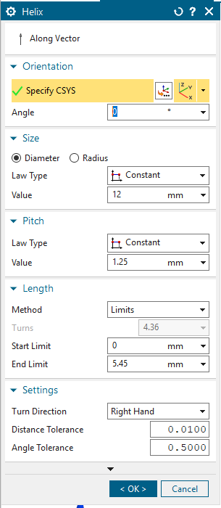
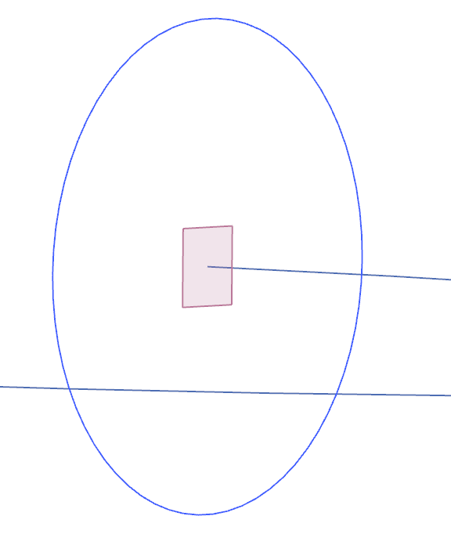
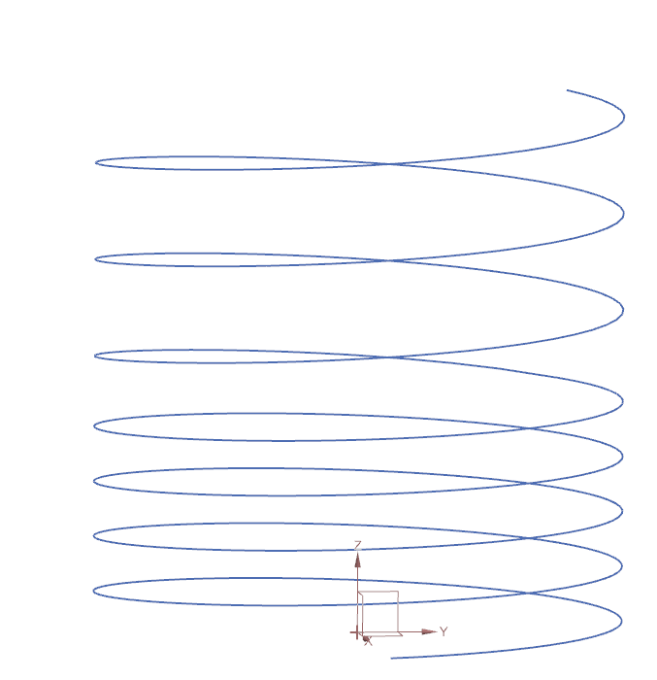
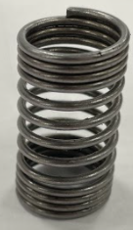
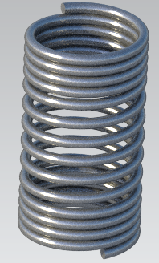
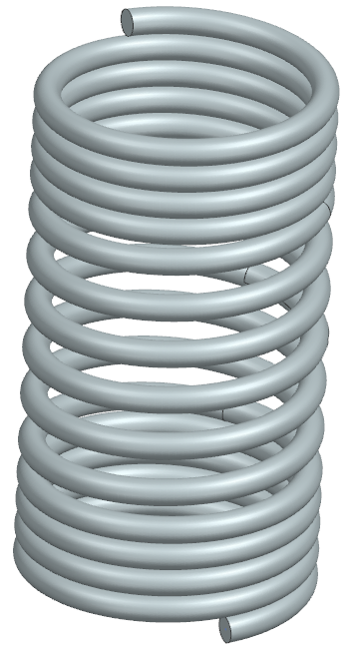
Helix & Sweep Along Guide (Hakancan Öztürk)

Slide 7
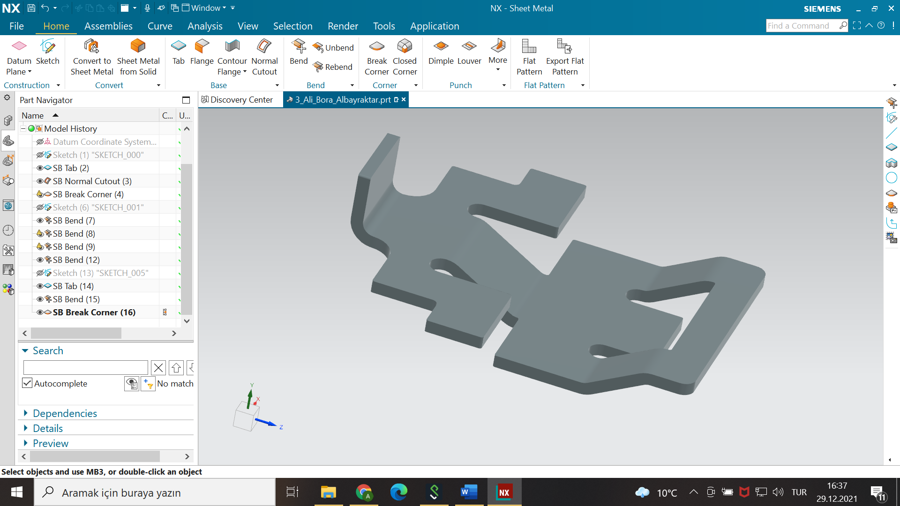
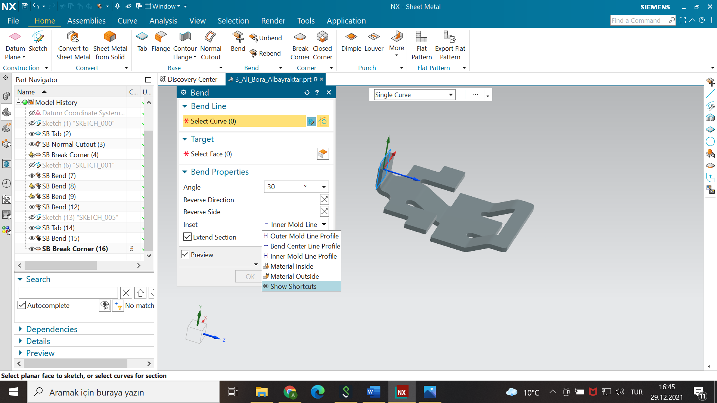
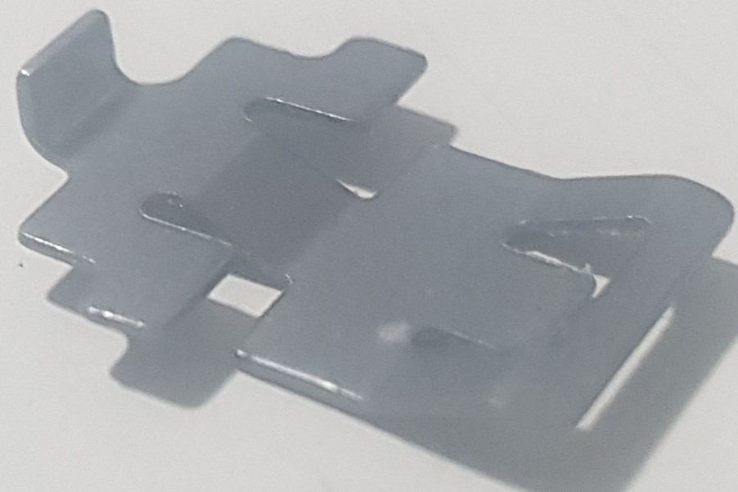
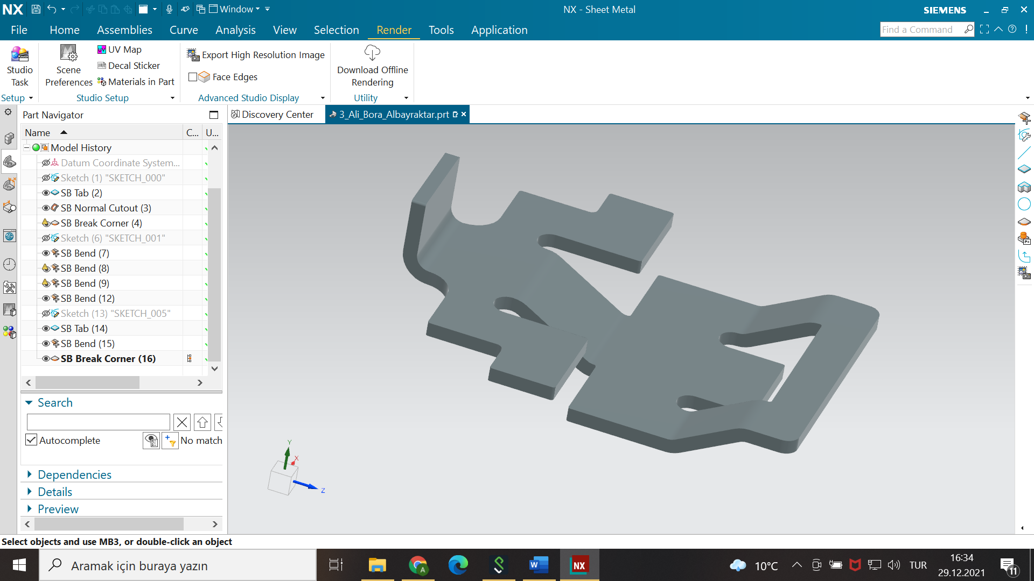
Sheet Metal (Ali Bora Albayraktar)

Slide 8
Parts List and Disassembly

Slide 9
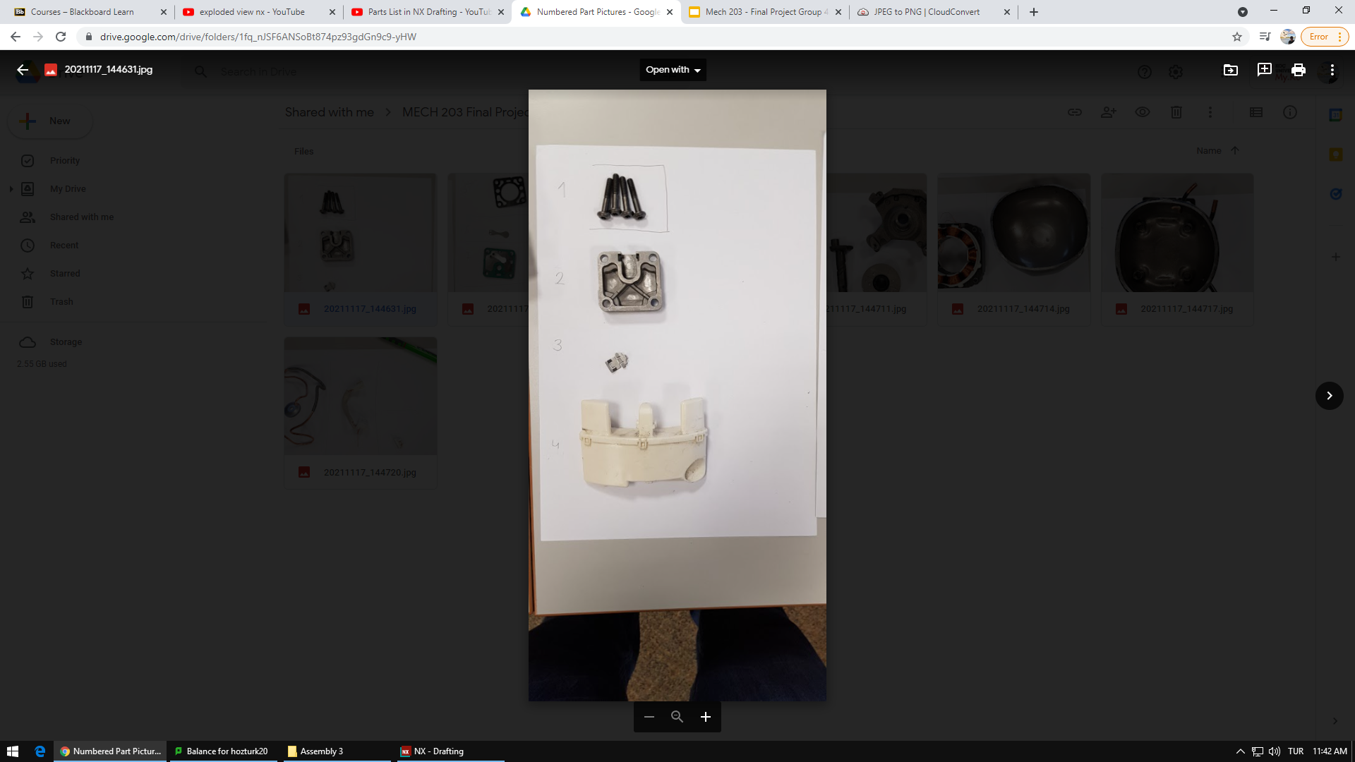
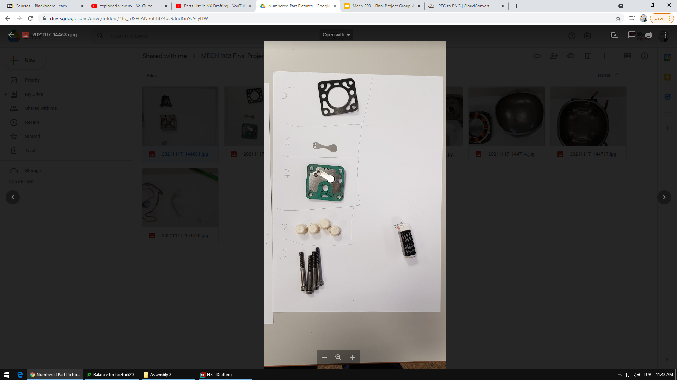
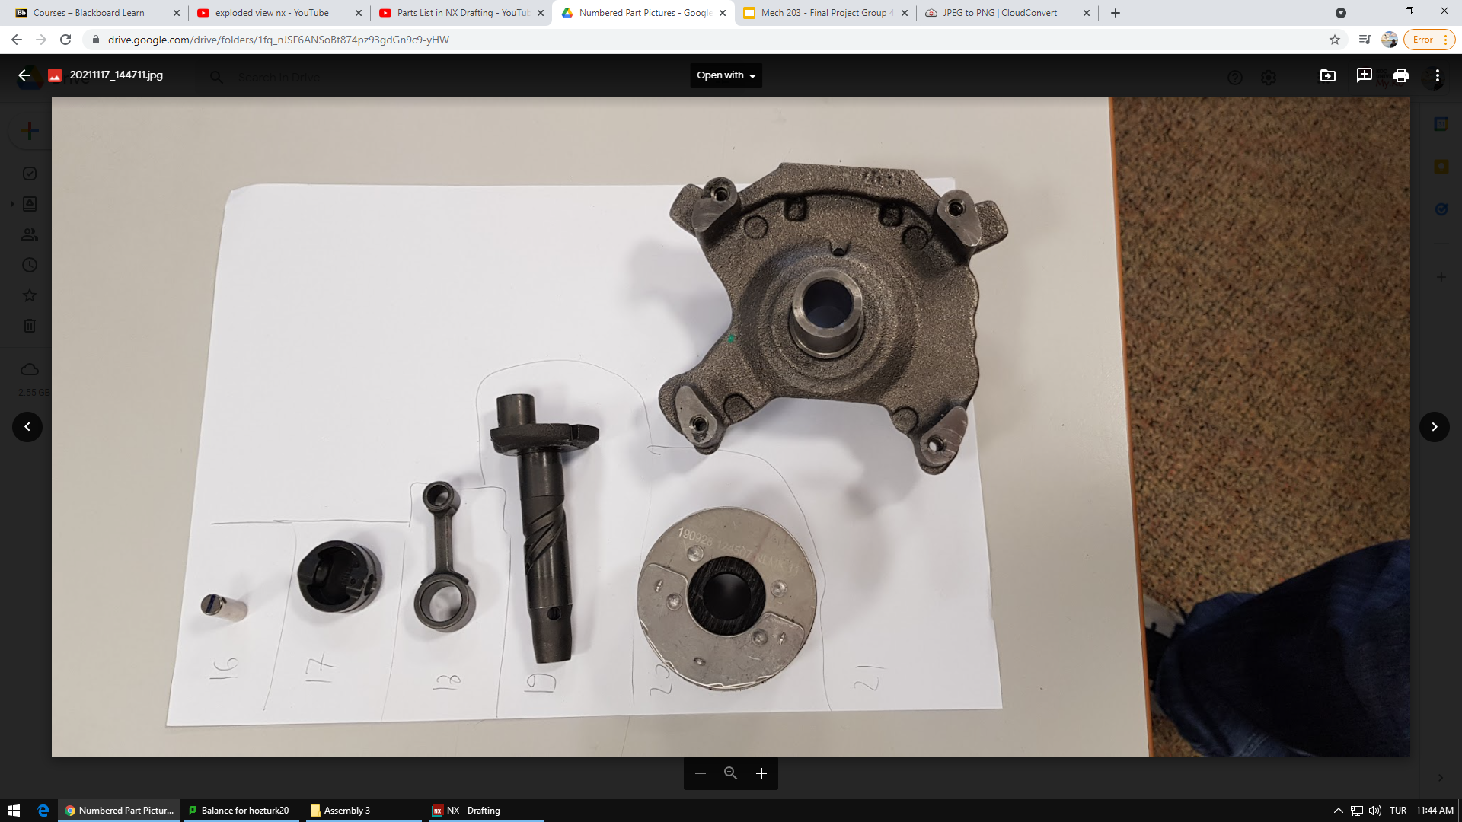
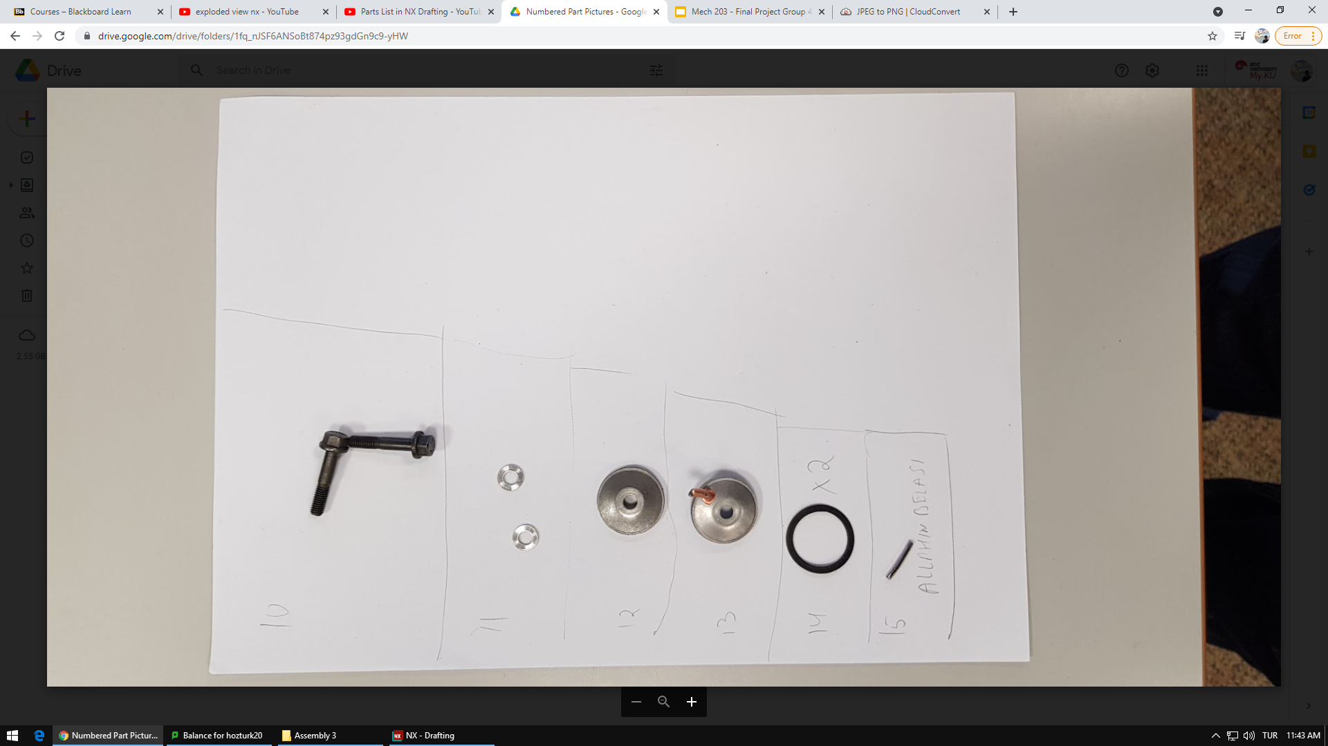
1- Hakancan
2- Umut
3- Ali Bora
4- Gökhan
5- Berk
6- Berk
7- Berk
8- Berk
9- Ali Bora
10- Ali Bora
11- Doruk
12- Doruk
13- Doruk
14- Doruk
15- Doruk
16- Hakancan
17- Ali Bora
18- Hakancan
19- Gökhan
20- Gökhan
21- Ali Bora

Slide 10
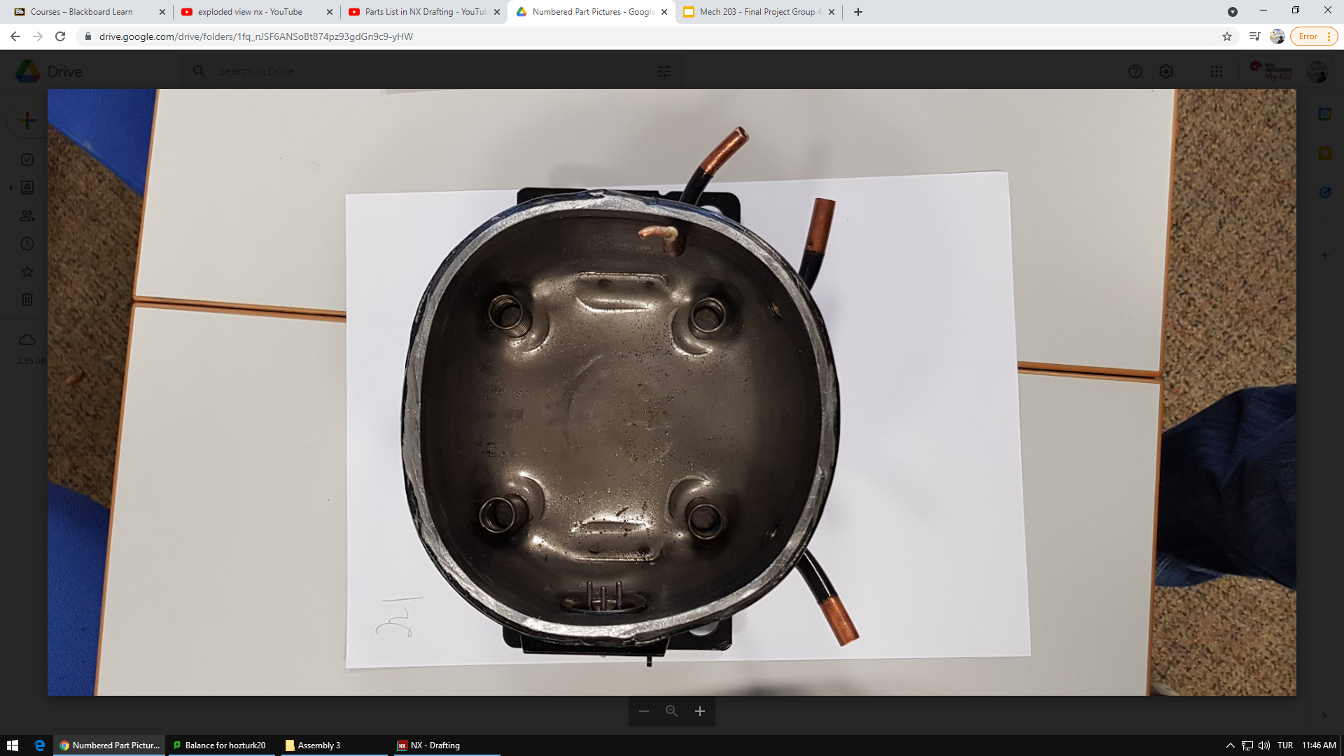
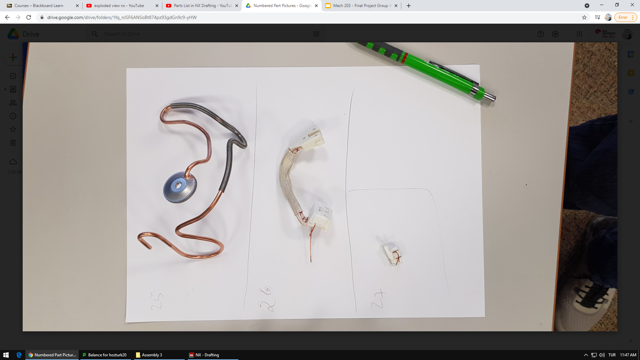
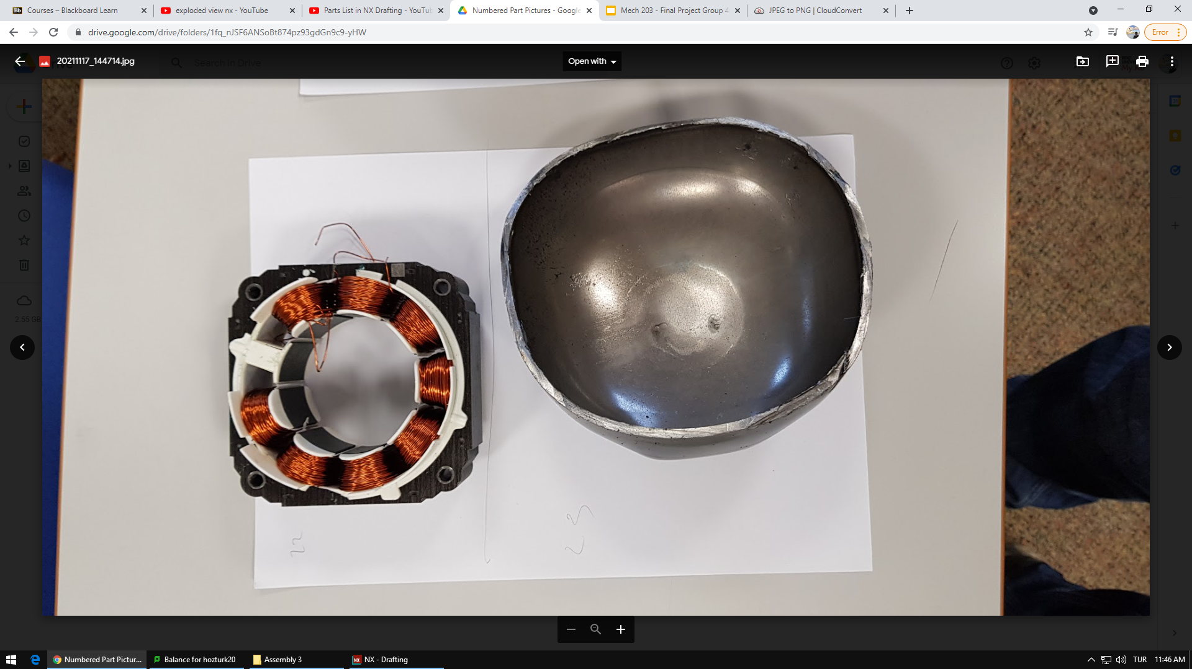
22- Hakancan
23- Berk
24- Hakancan
25- Gökhan
26- Hakancan

Slide 11
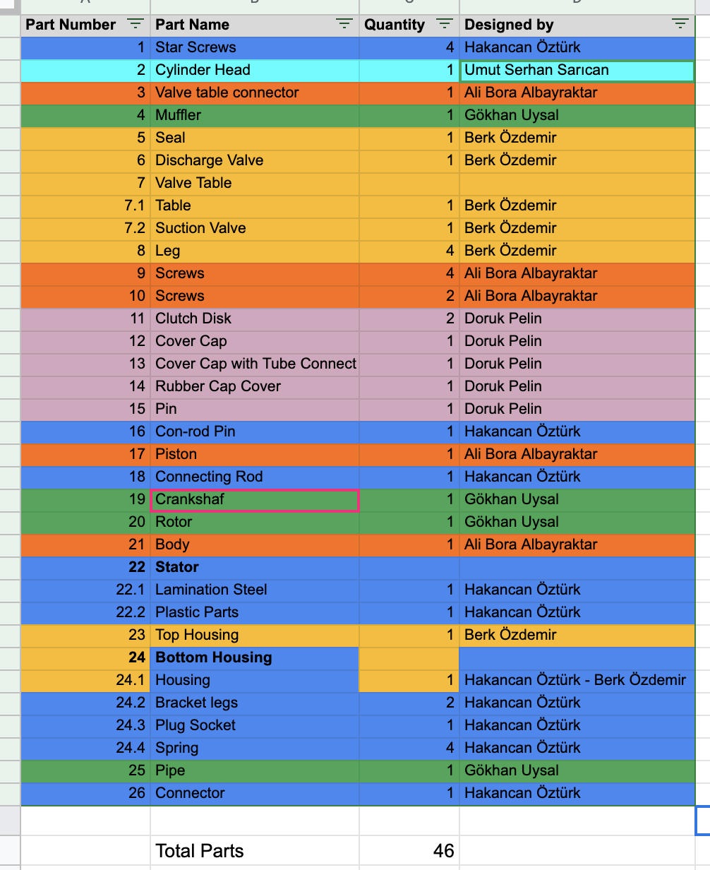
Parts List
Total: 46
Unique: 35

Slide 12
Assembly Sequence & Exploded Views
(Assembly sequence by Gökhan Uysal and Exploded View by Hakancan Öztürk)

Slide 13
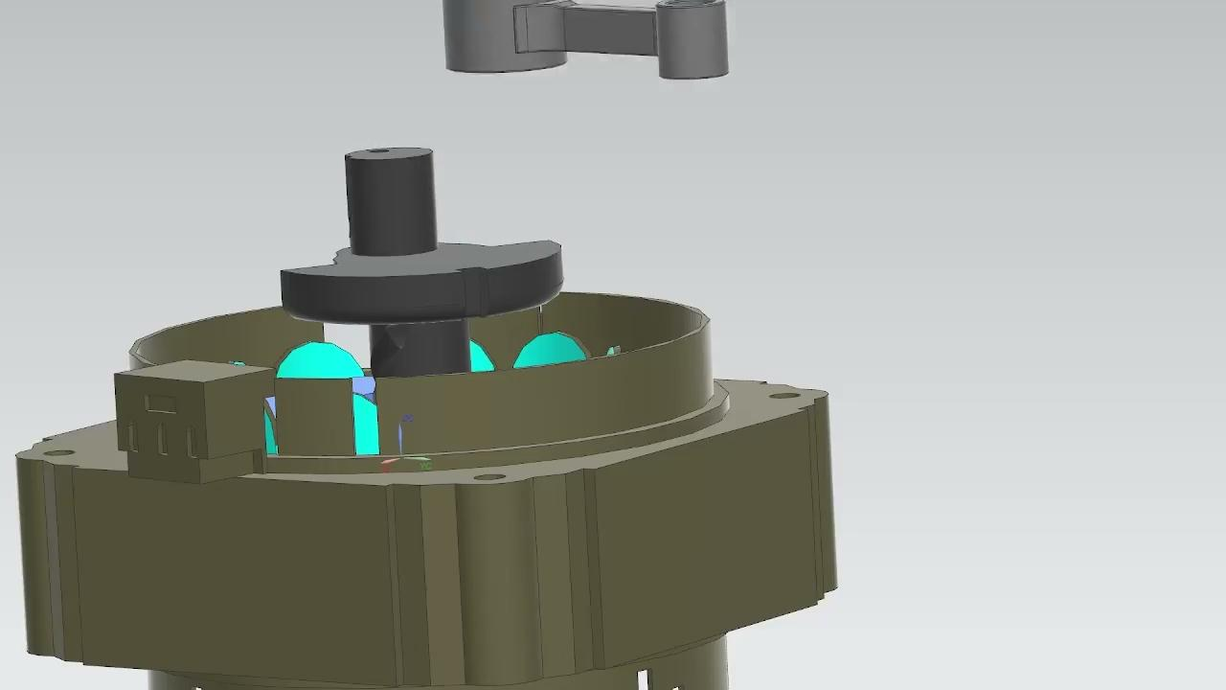
Assembly Sequence

Slide 14
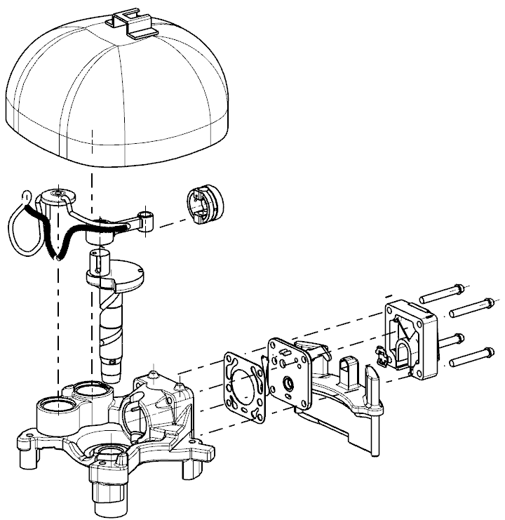
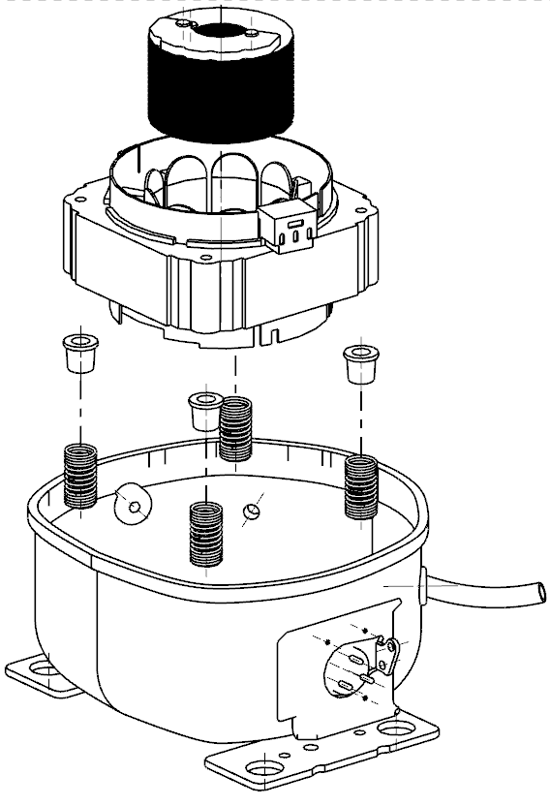
Top Housing
Rotor
Connecting Rod
Stator
Piston
Legs
Springs
Krankshaft
Muffler
Lower Housing
Body
Notes:
Add names + components

Slide 15
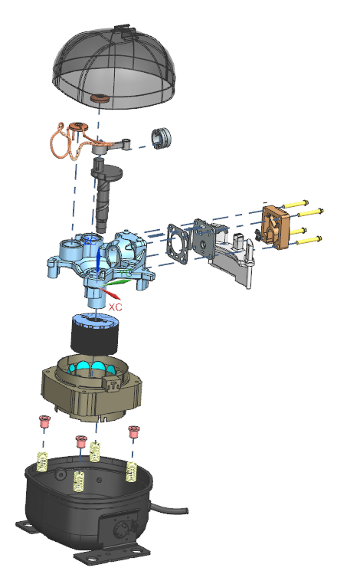
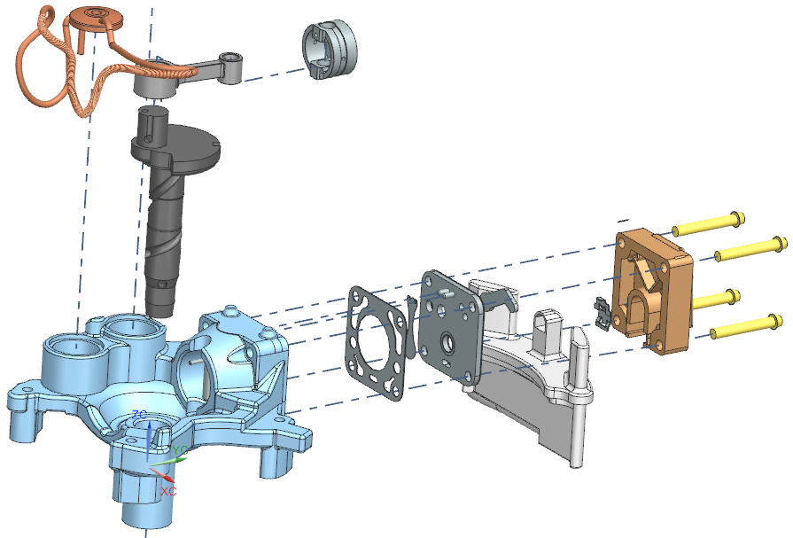
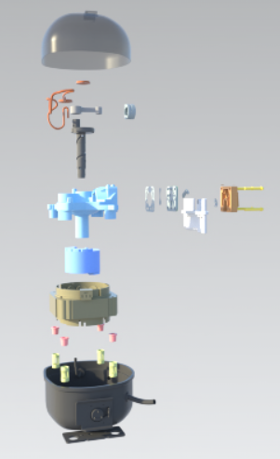

Slide 16
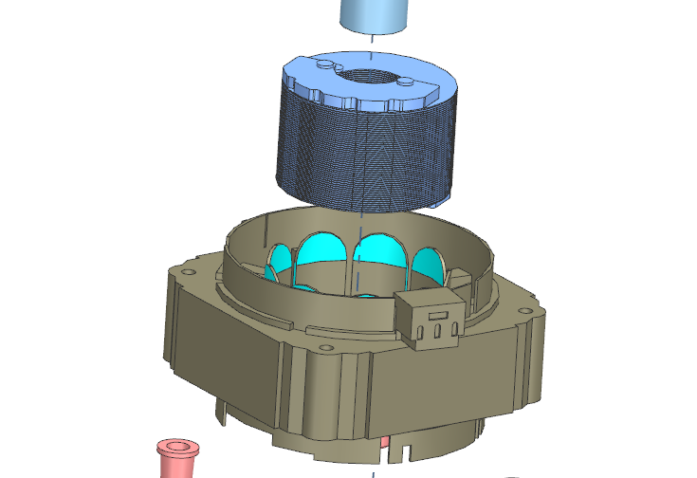
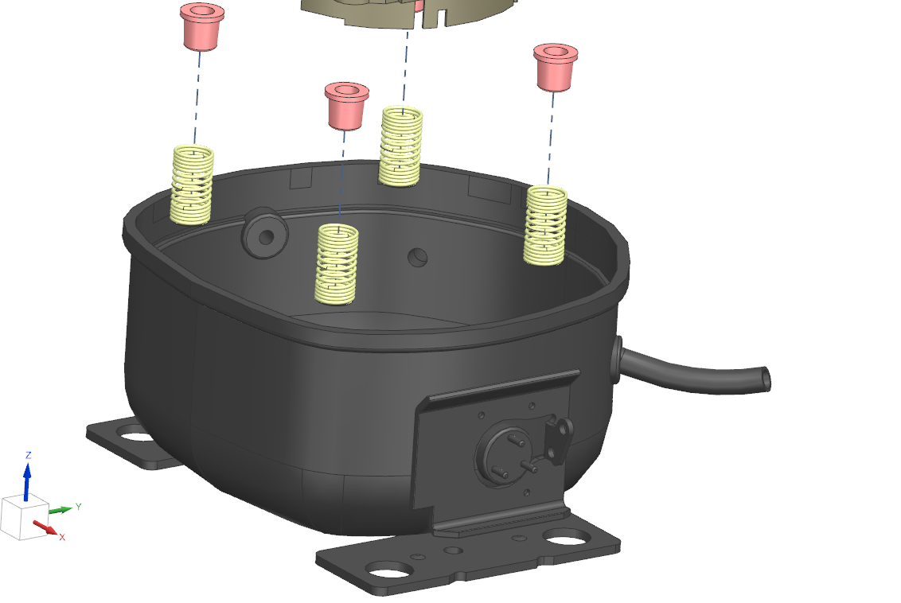

Slide 17
Part Comparisons

Slide 18
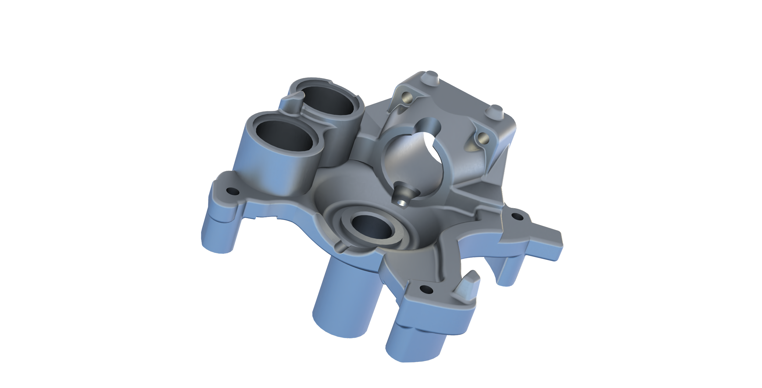
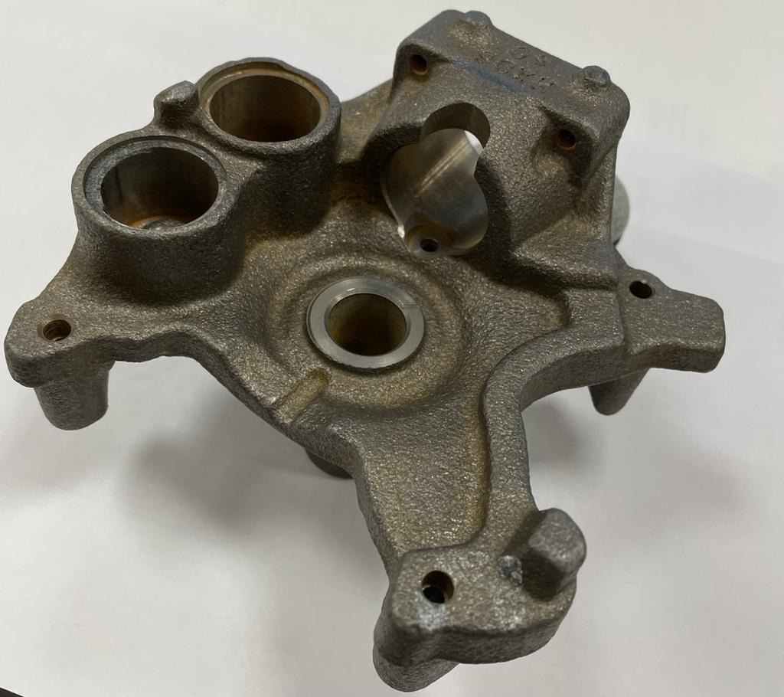
Part 1: Body (Gray Cast Iron) (Ali Bora)
Notes:
Render + add color

Slide 19
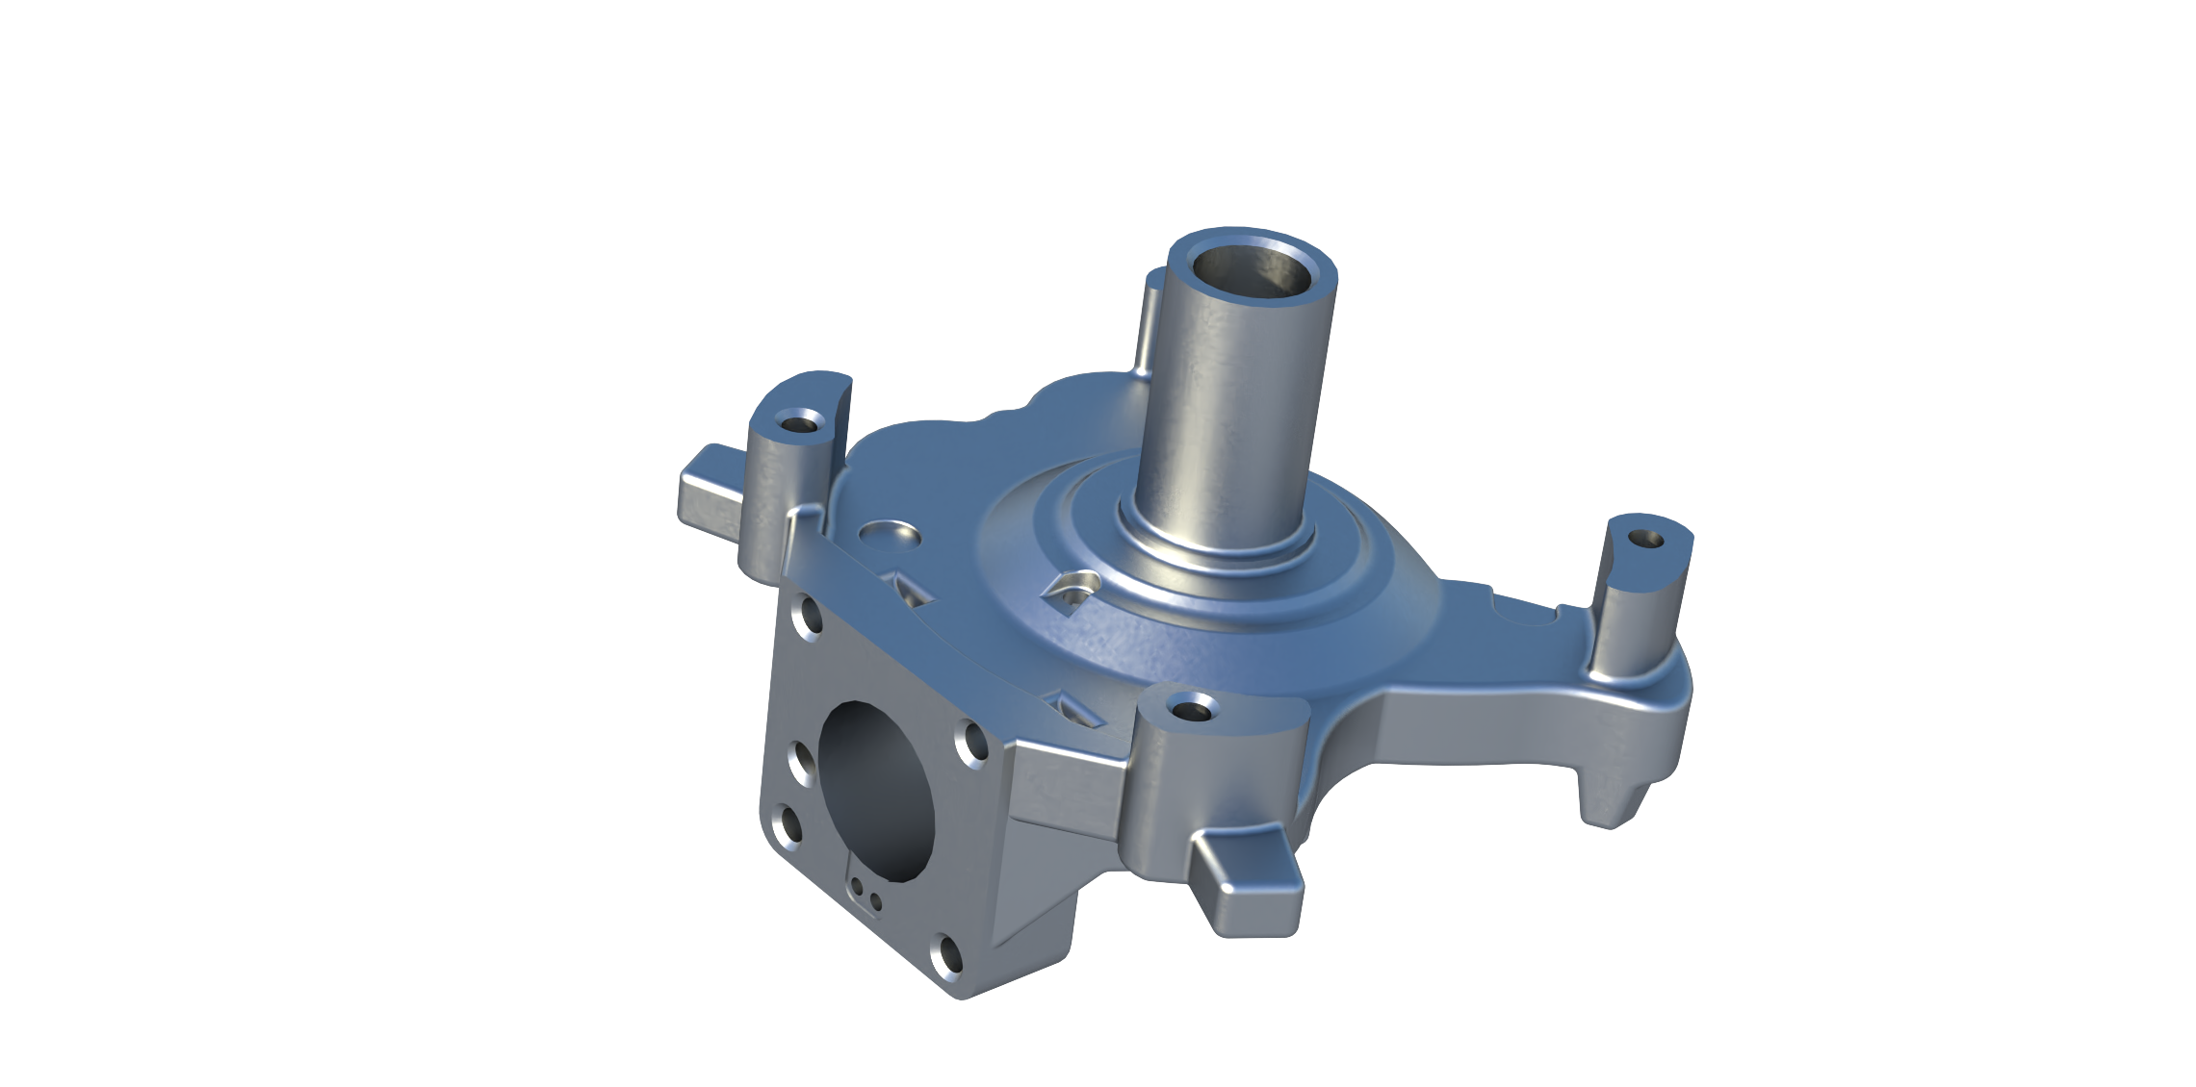
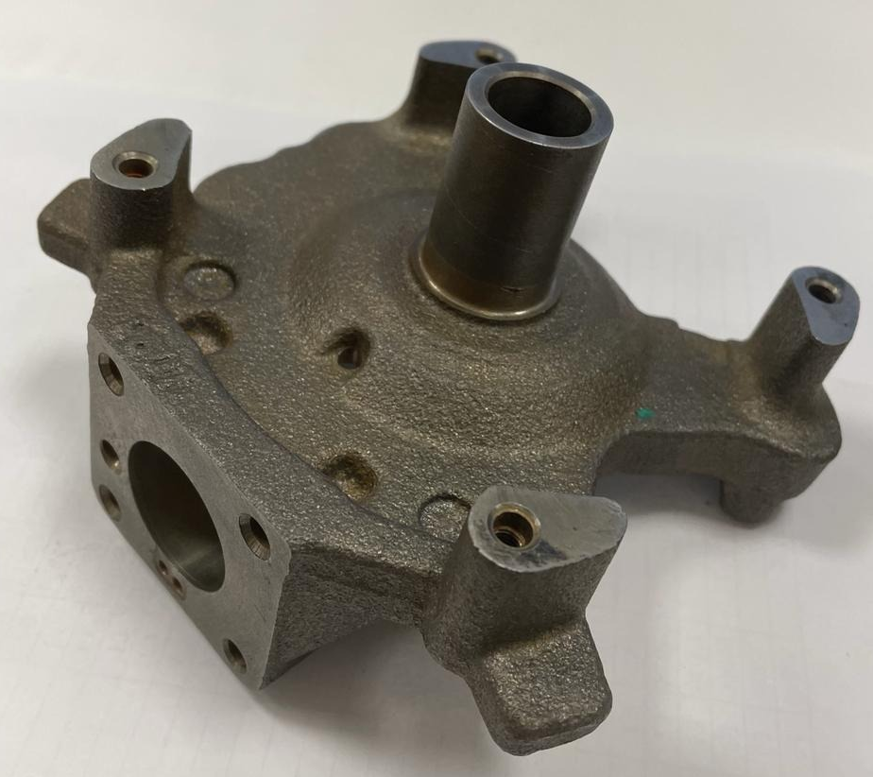
Part 1: Body (Gray Cast Iron) (Ali Bora)

Slide 20
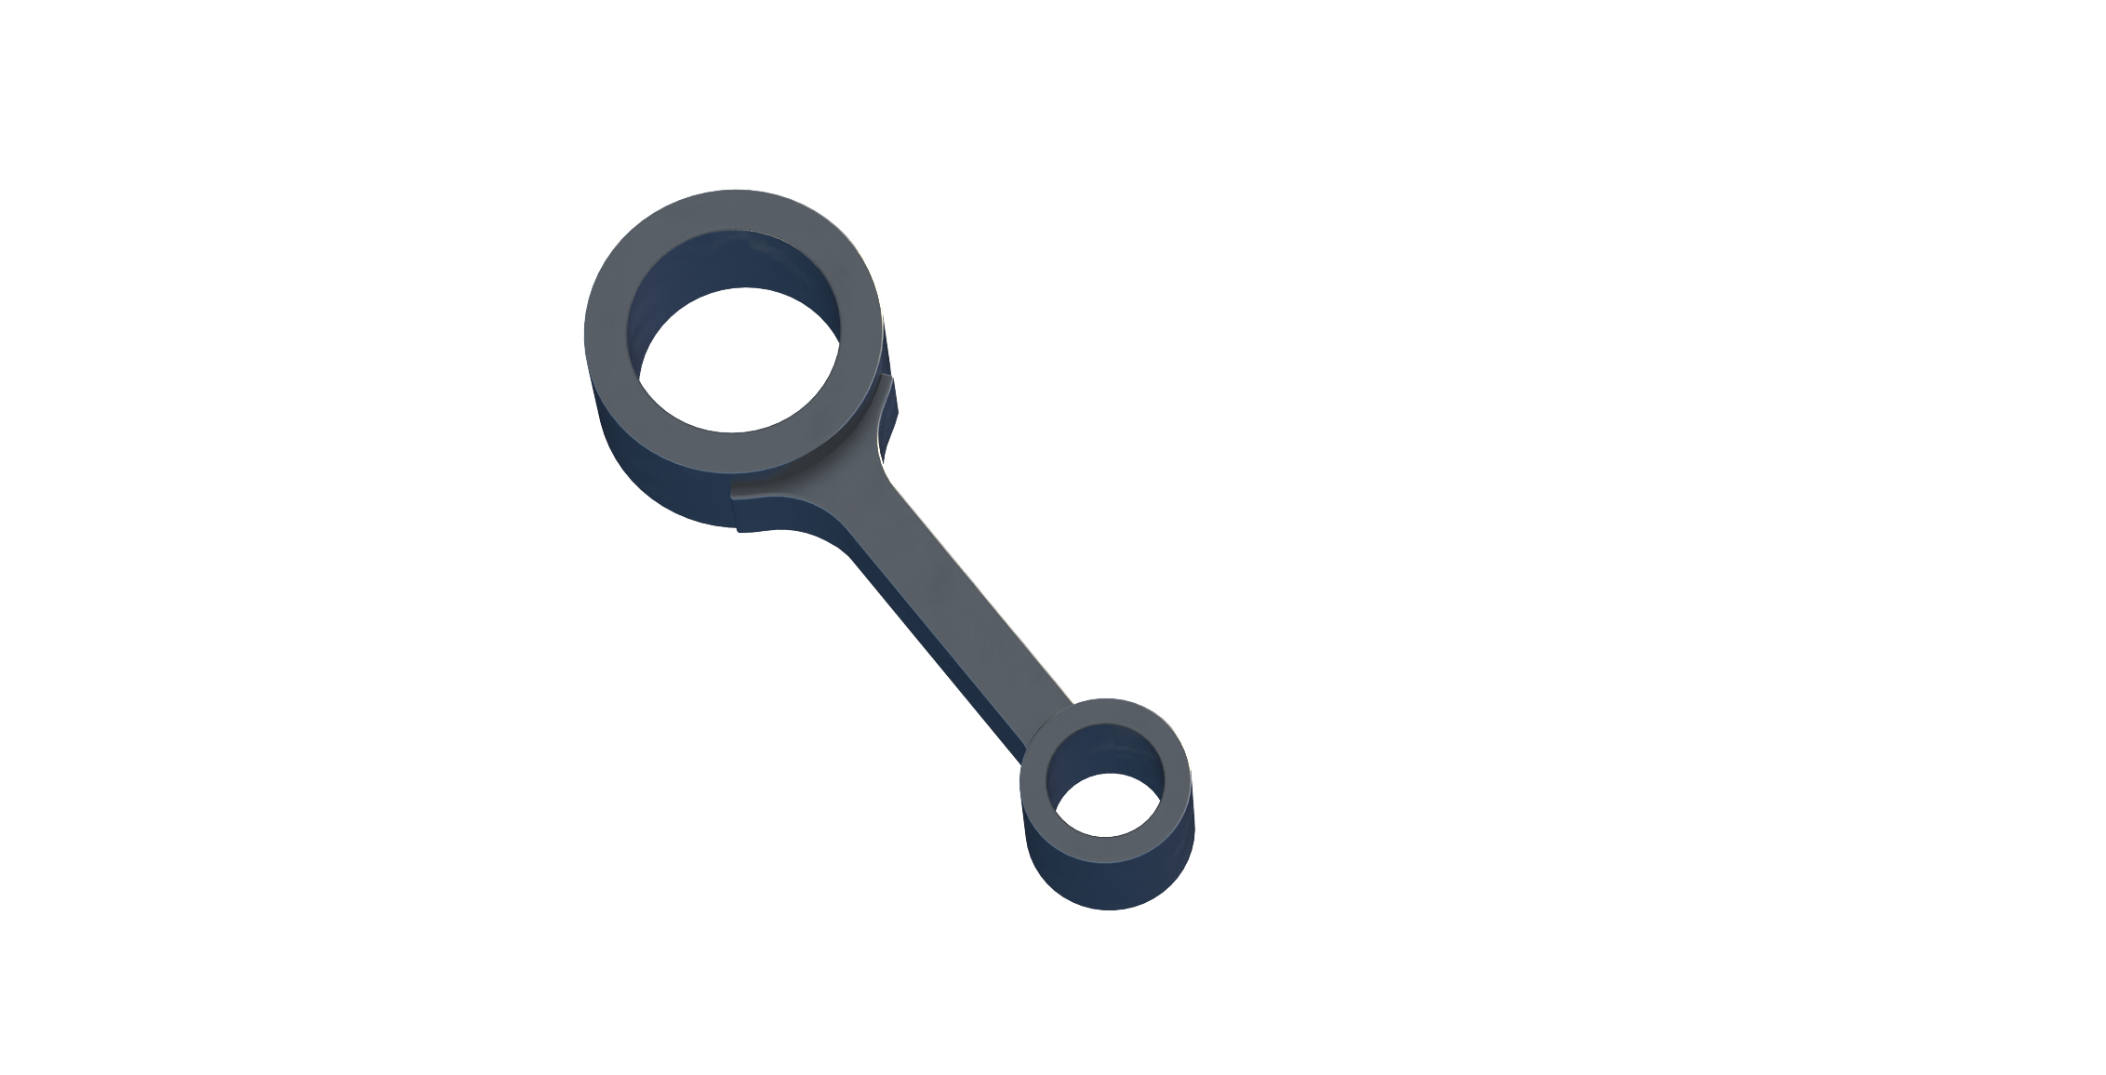
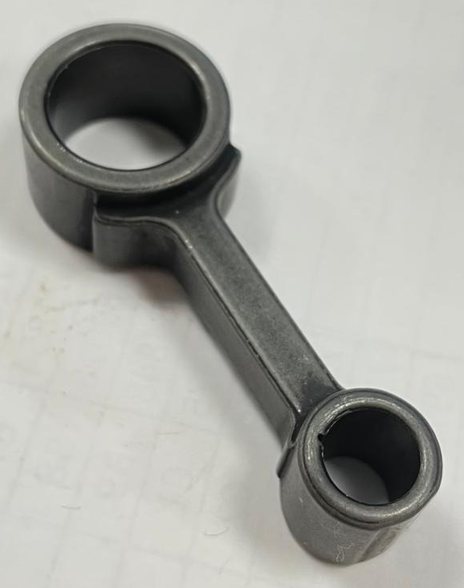
Part 2: Connecting Rod (Gray Cast Iron) (Hakancan)

Slide 21
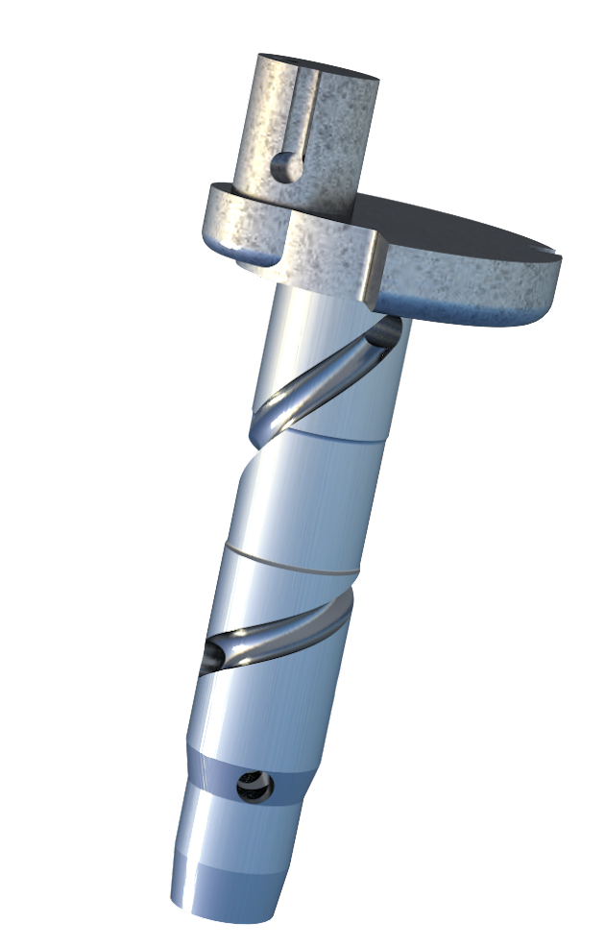
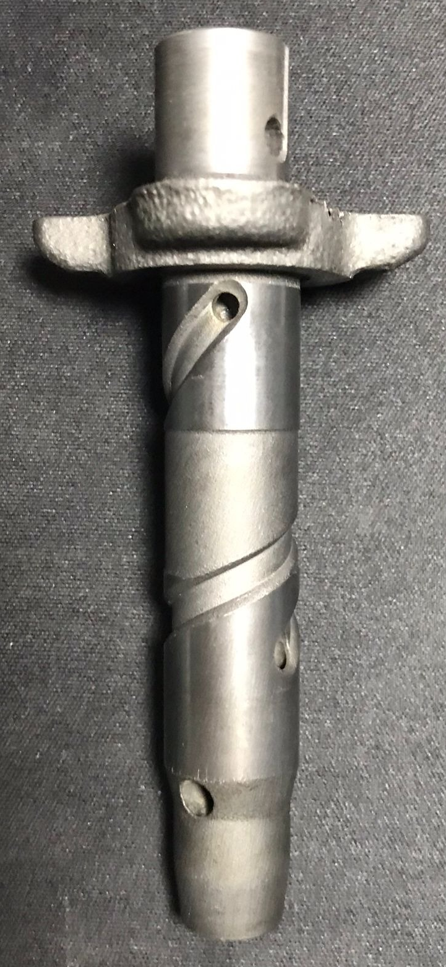
Part 3: Crank Shaft (Gray Cast Iron) (Gökhan)

Slide 22
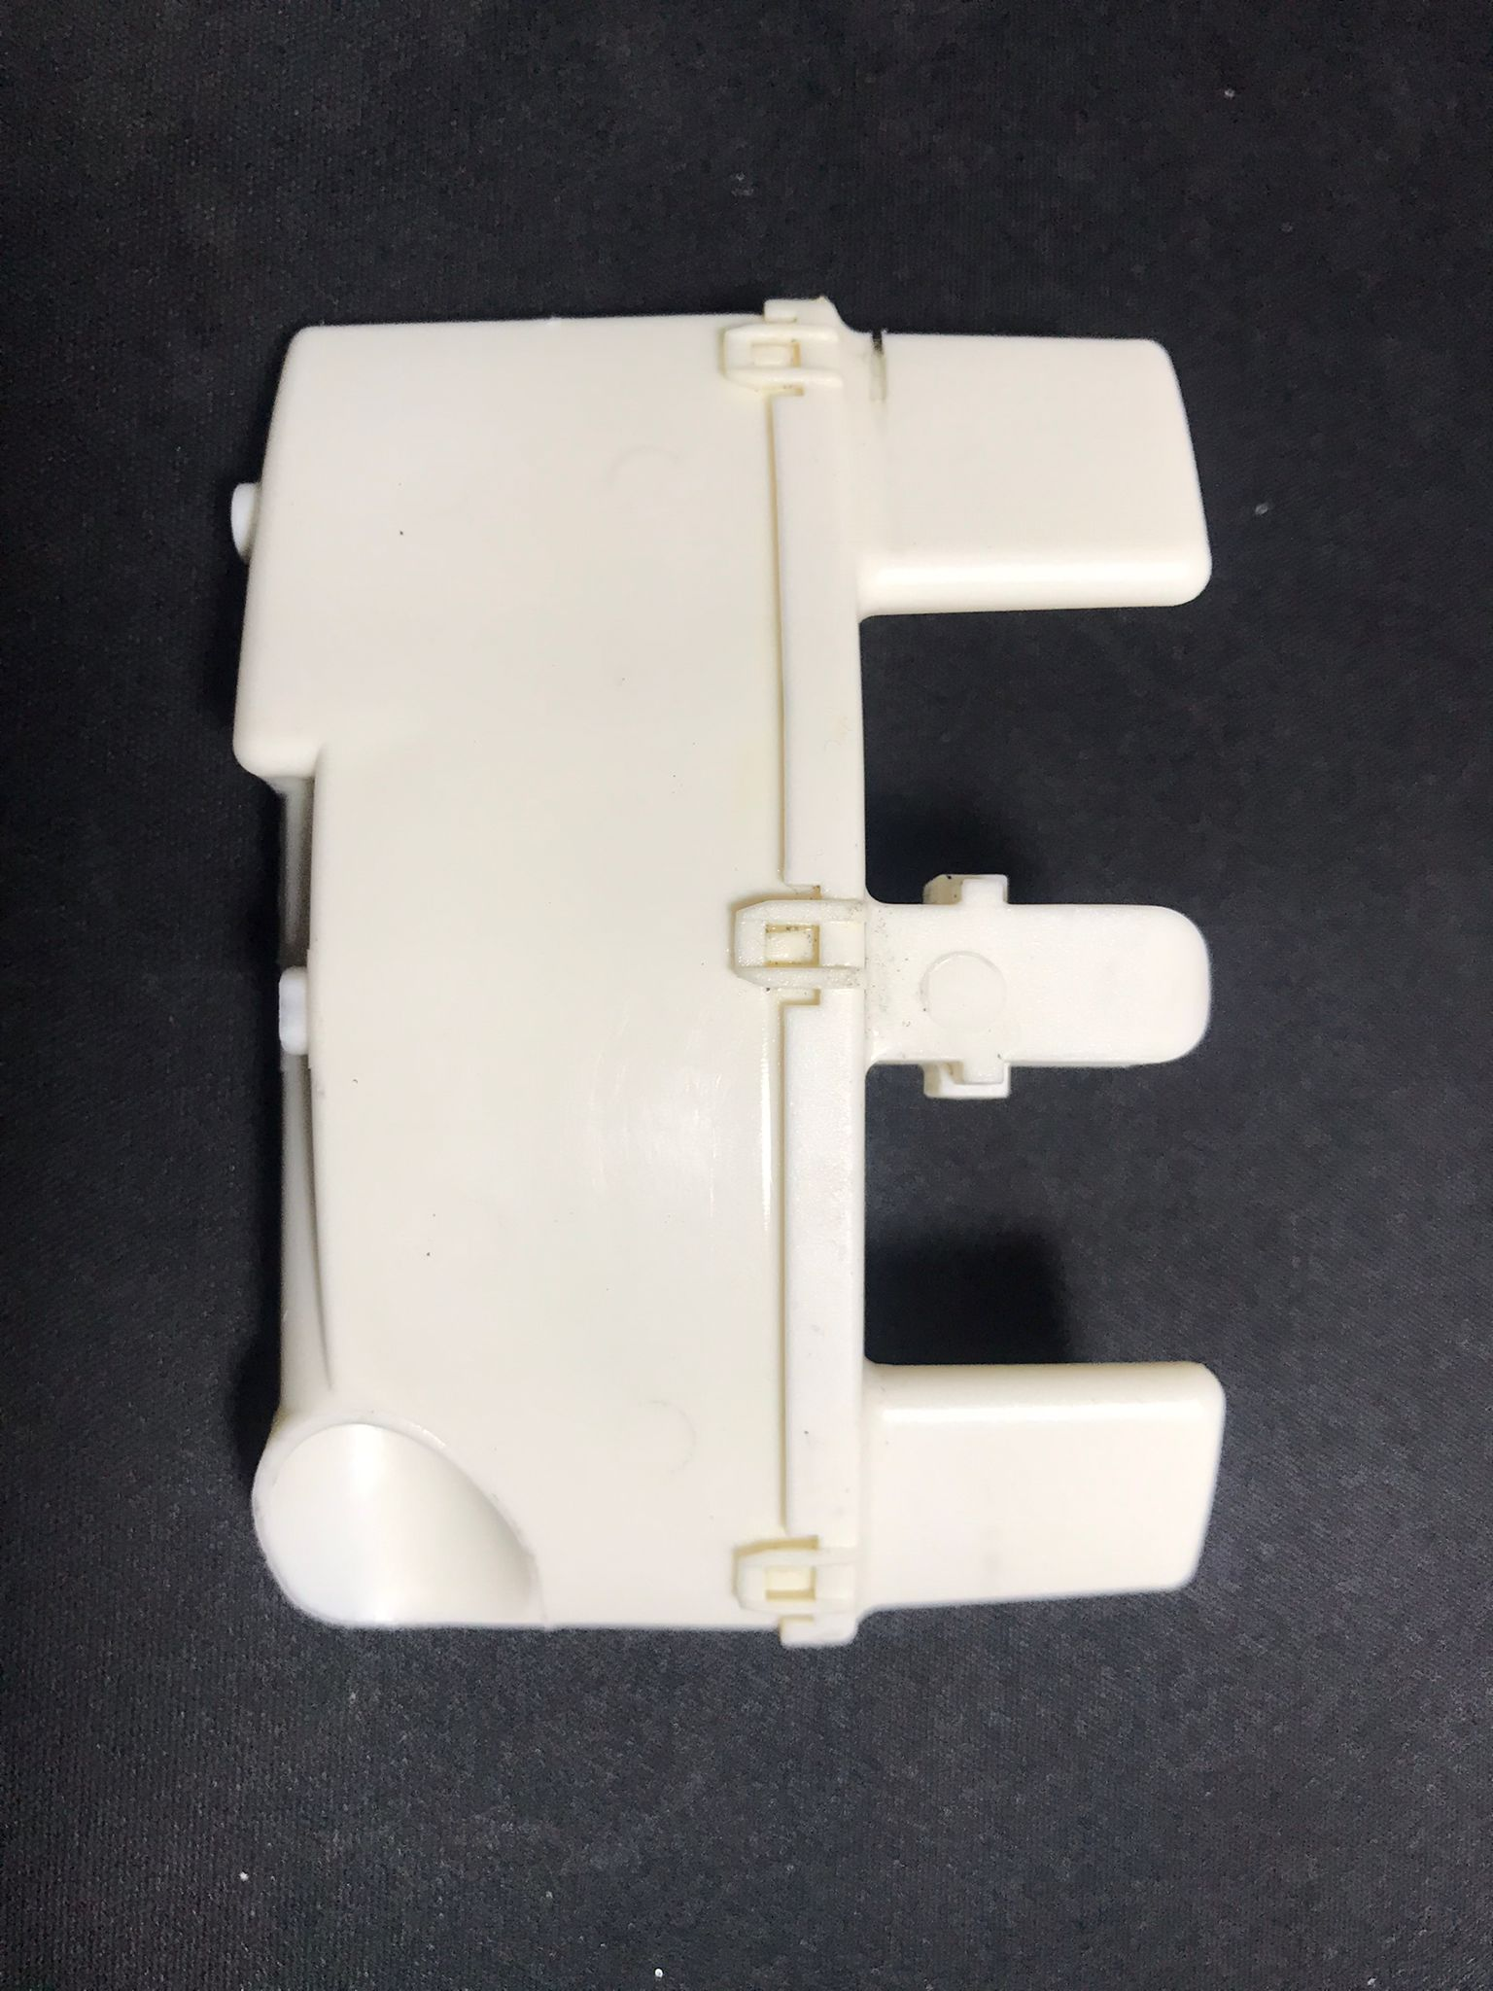
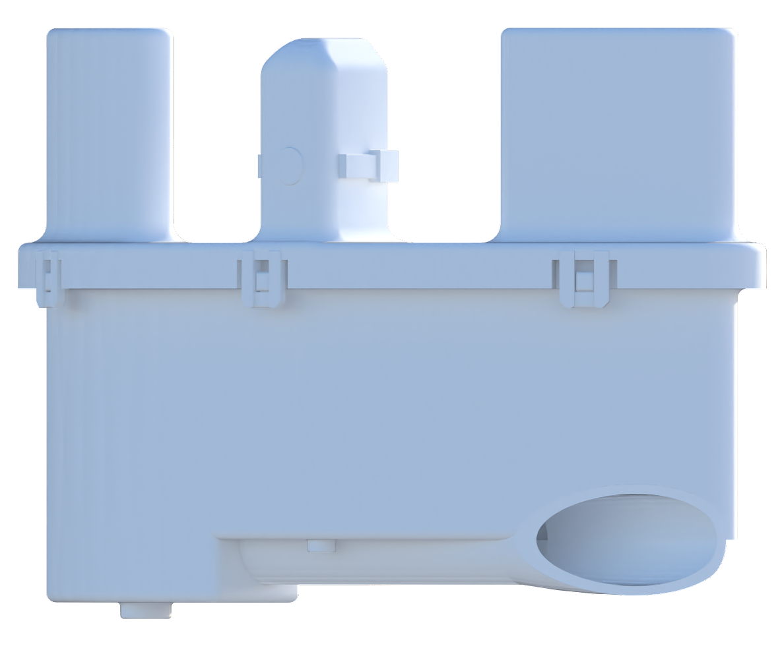
4) Muffler (PBT Plastic) (Gökhan Uysal)

Slide 23
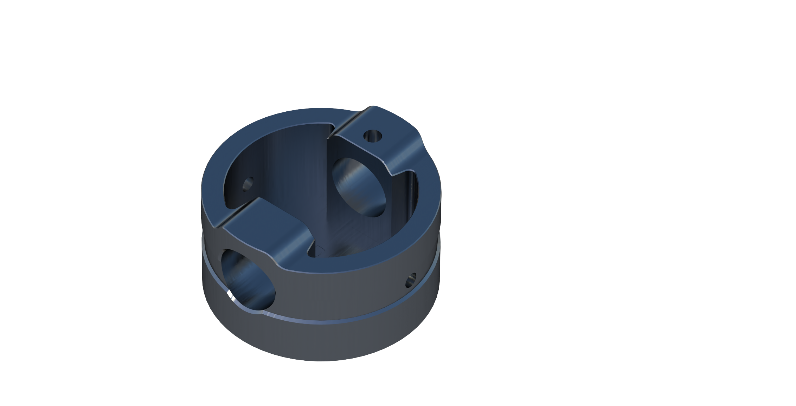
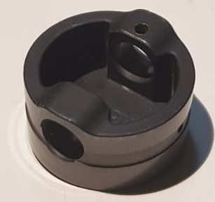
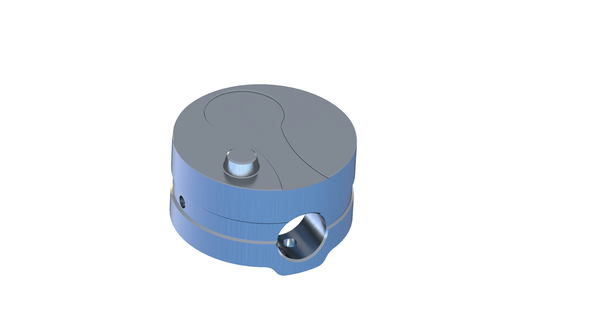
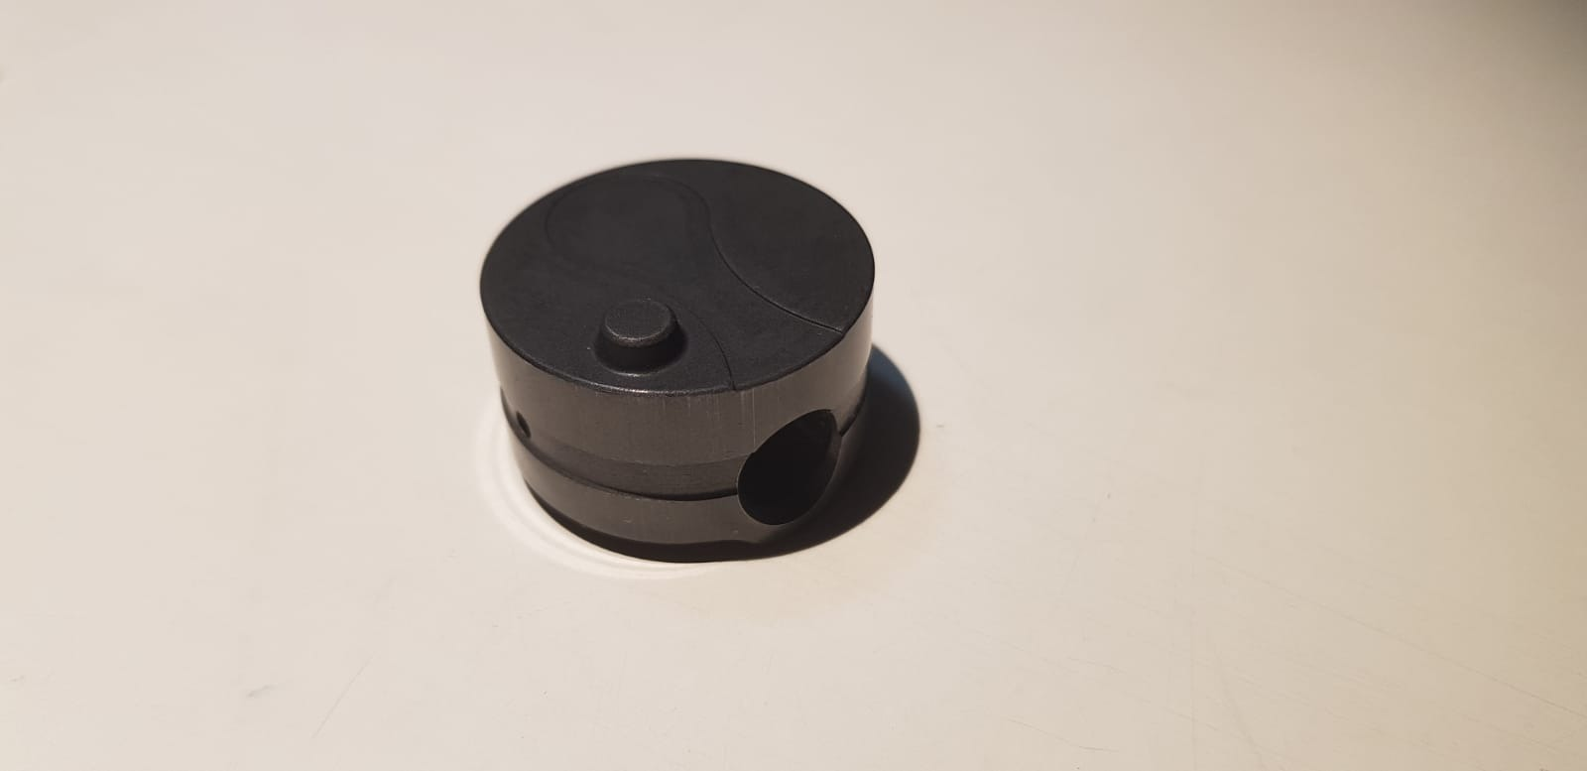
Part 5: Piston (Gray Cast Iron) (Ali Bora)
Notes:
Pistonlar ayni yere

Slide 24
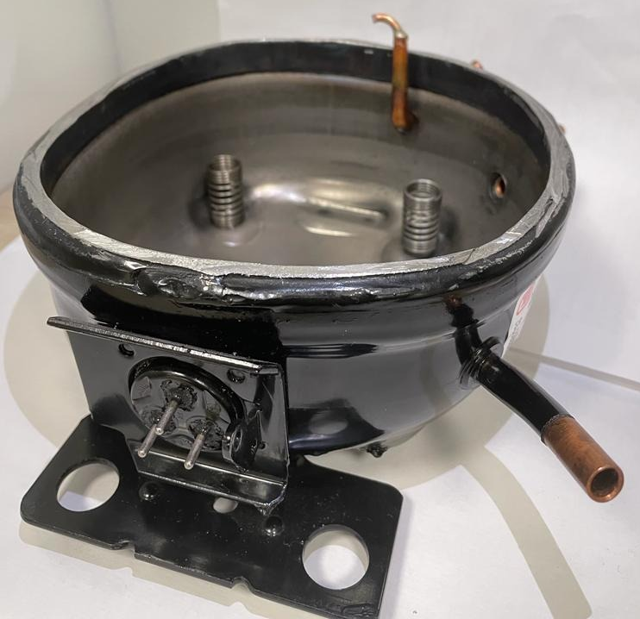
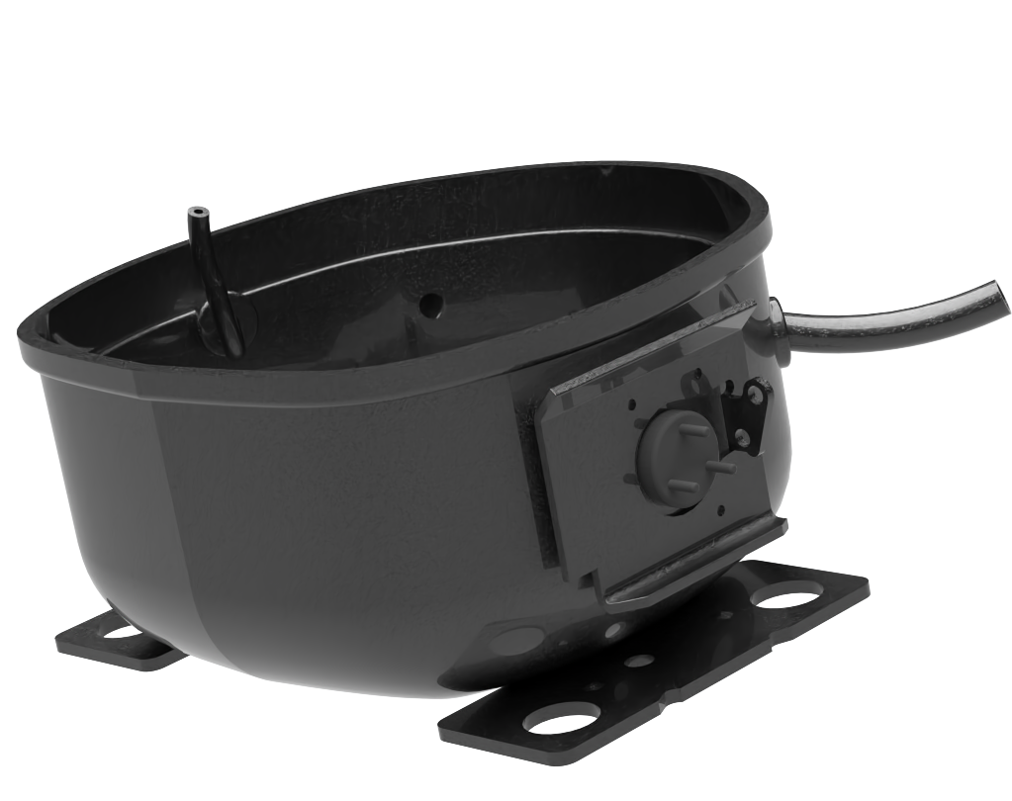
Part 6: Bottom Case (Sheet Metal) (Hakancan)

Slide 25
Drafts and Drawings

Slide 26
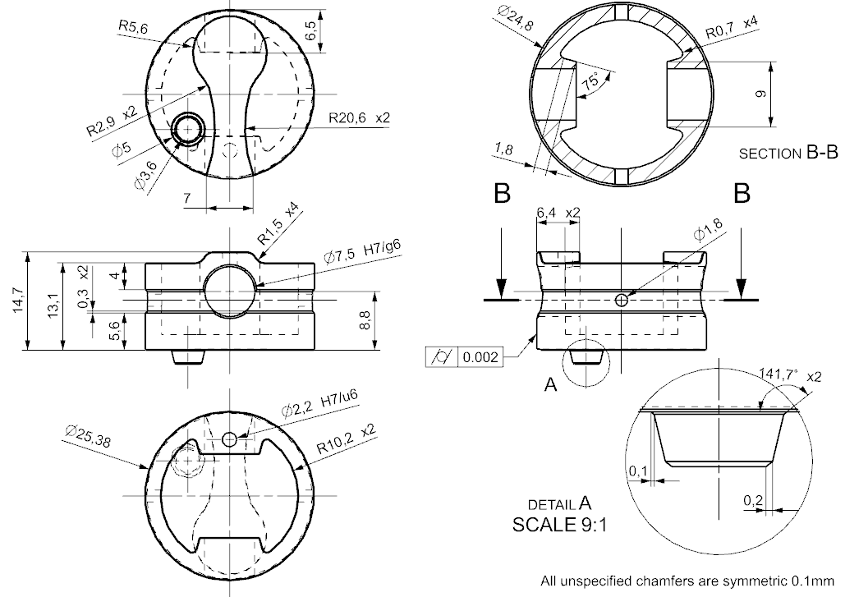
Piston (Part & Draft by Ali Bora Albayraktar)

Slide 27
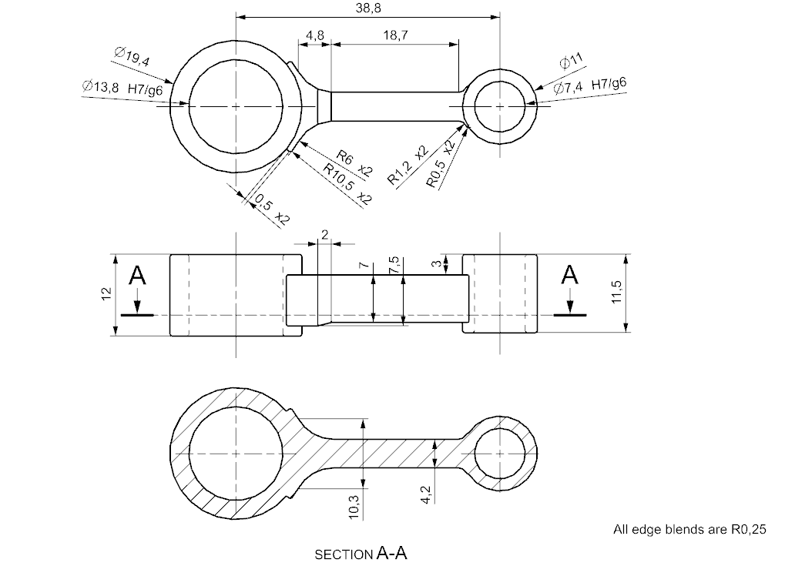
Connecting Rod (Part by Hakancan Öztürk, Drafting by Ali Bora Albayraktar)

Slide 28

Lamination Sheet (Part by Hakancan Öztürk, Drafting by Ali Bora Albayraktar)

Slide 29
Motion Simulation
(Gökhan Uysal)

Slide 30



Motion Simulation
Discharge Valve
Inner pipe
Suction Valve

Slide 31
Finite Element Analysis
(Berk Özdemir)

Slide 32
Finite Element Analysis of Stress on the Piston
Materials (from Ansys library):
Gray Cast Iron
Boundary Conditions:
Pressure: 0.8 MPa
Fixed Support: The hole where pin connects

Slide 33

Boundary Conditions
Fixed support applied to the holes where pin connects.
8 bar (0.8 MPa) pressure applied on the bottom of the piston.

Slide 34

Mesh
Element Size: 10⁻³ m
Number of Nodes: 54148
Number of Elements: 34231

Slide 35



Results

Slide 36

Computational Fluid Dynamics (CFD) Analysis
(Ali Bora Albayraktar)

Slide 37

CFD Analysis of Flow Inside the Pipe
A steady-state, laminar flow inside the pipe.
Materials (from Ansys library):
Fluid: air
Solid: 316L stainless steel
Boundary Conditions:
Pressure Inlet: 800 kPa
Mass Flow Outlet: 0.0273 g/s
Wall: No slip
Notes:
Ilk basa tasi

Slide 38

Mesh
Element Size: 6.679 mm
Number of Elements: 314908
Number of Nodes: 331945

Slide 39

Results
Pressure losses will decrease the efficiency of the refrigeration cycle.
Friction losses are present in every pipe, but bends in pipes may cause significant friction losses as well.
70 Pa lost in this case

Slide 40

Results
Total pressure loss:
781 Pa (0.097625 %)
The pipe is an effective vessel!

Slide 41





Slide 42
Thanks for listening!

